Slide 1
DYNAMIC PROGRAMMING
EDIT DISTANCE

Slide 2
Dynamic Programming (Review)
Shortest Path in DAGs
Longest Increasing Subsequence
Today: Edit Distance

Slide 3
EDIT DISTANCE
Between Two Words
The minimum number of Insert/Delete/Overwrite to convert one word to another

Slide 4
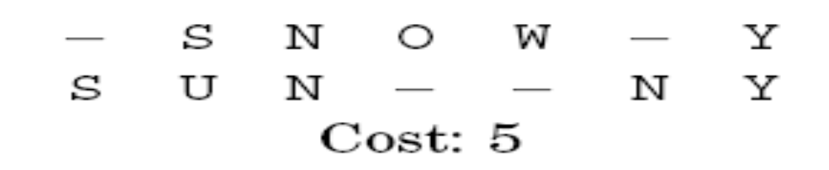

The Problem
A natural measure of the distance between two strings is the extent to which they can be aligned, or matched up. For instance, an alignment of SNOWY and SUNNY:

Slide 5
The Problem (Contd.)
The cost of an alignment is the number of columns in which the letters differ.
And the edit distance between two strings is the cost of their best possible alignment.

Slide 6
A DYNAMIC PROGRAMMING SOLUTION
What Are The Sub-Problems?

Slide 7
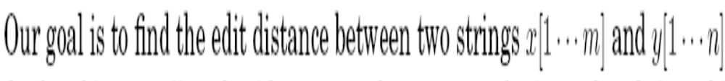
edit distance between some prefix of the first string, x[1 … i], and some
prefix of the second, y[1 … j]

Slide 8
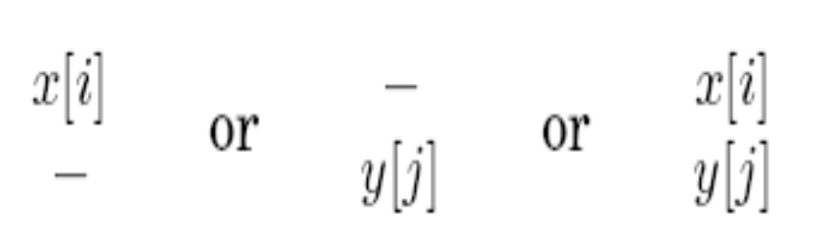
Expressing E(i, j) in terms of smaller sub-problems.
Rightmost column can only be one of three things:

Slide 9
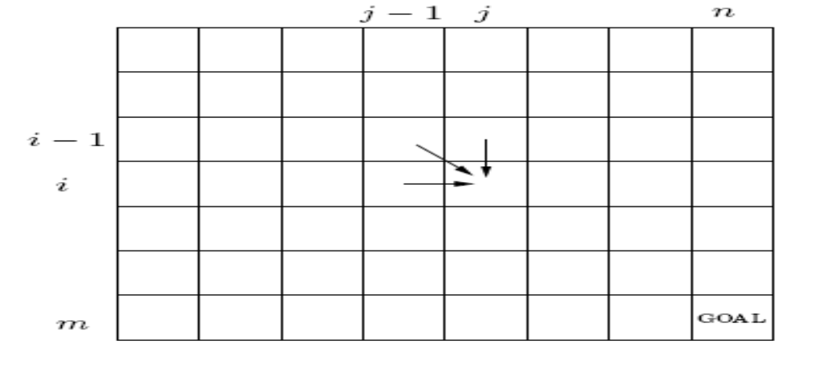
The answers to all the subproblems E(i , j) form a two-dimensional table
In what order should these sub-problems be solved? E(i - 1, j), E(i , j - 1), E(i - 1; j - 1) are to be handled before E(i , j)

Slide 10
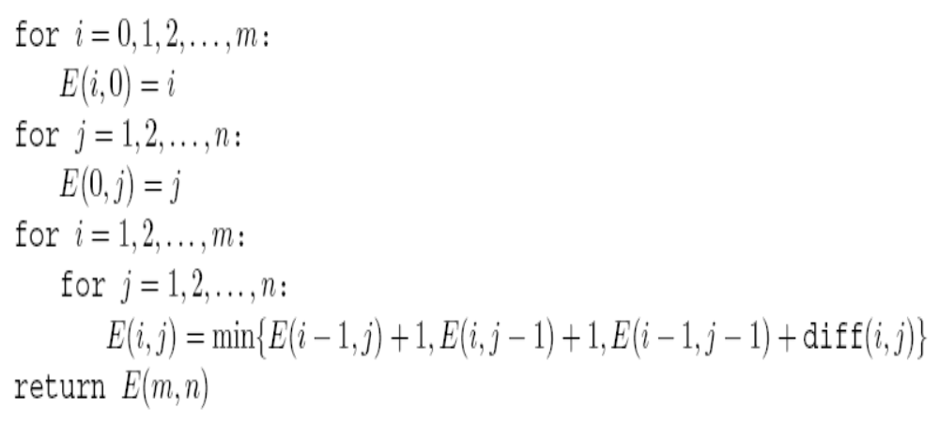
ALGORITHM

Slide 11
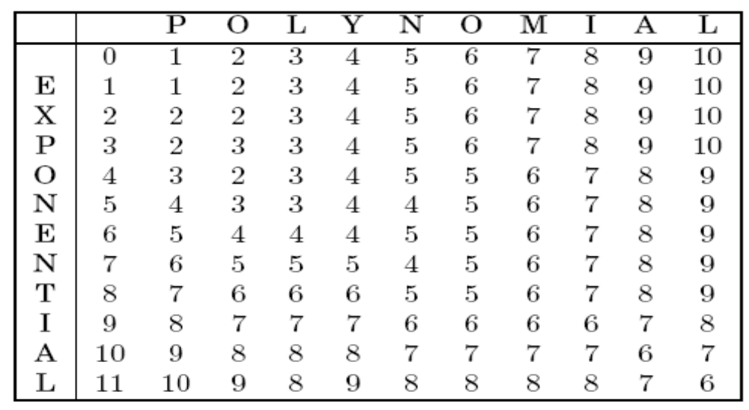
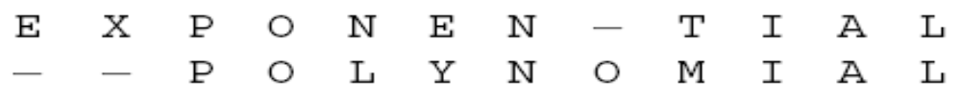
Example: Edit Distance between EXPONENTIAL and POLYNOMIAL

Slide 12
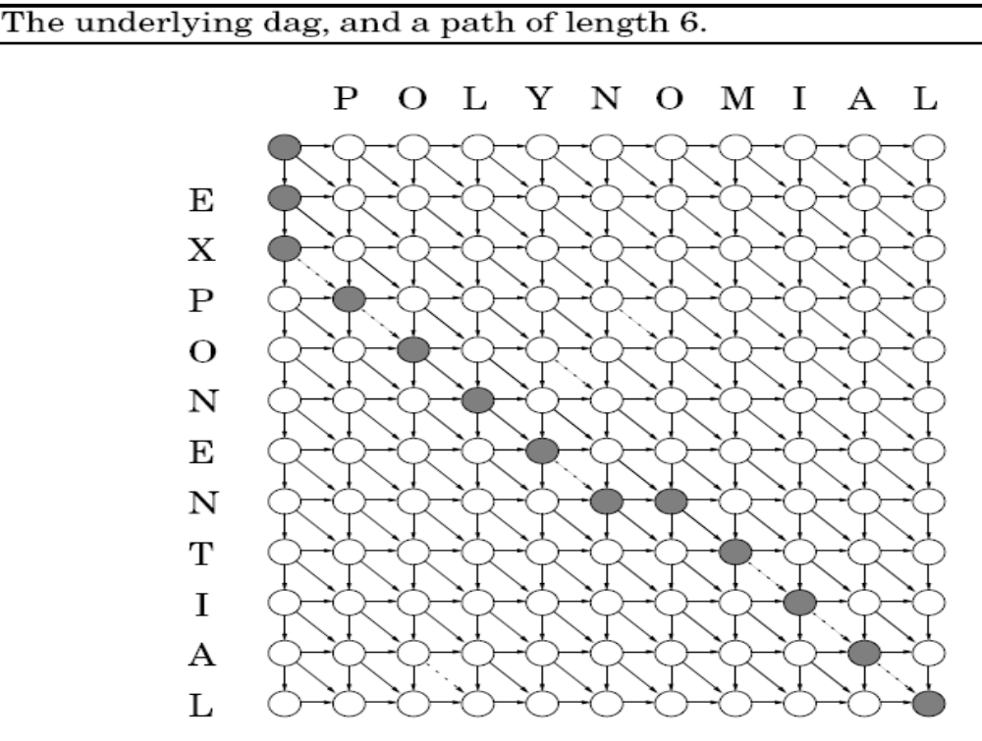

Slide 13
THANK YOU
Any Questions?
SUMMARY:
Edit Distance between x[1,…,n] and y[1,…m] in time:
O(mn)

Slide 14
How To Choose (Y)Our Projects?
Dear Students,
Please ignore if you have better ideas!
Yours Sincerely,
Kannan Srinathan

Slide 15
Most (if not all) decisions are based on how one answers some simple questions
And to make it simpler, let’s make it
objective multiple-choice questions
Disclaimer: It’s your choice for the day; no answer is to be “judged” as superior or inferior to another.

Slide 16
#1: The Direction-of-Benefit Question
Do You Wish To:
[A] Get Something
[B] Give Something
[C] Get More by Giving
[D] Give More by Getting
(It goes without saying “in/from your project”)

Slide 17
#2: The Driving-Force Question
Why Did You Take This Course:
[A] To Learn about Algorithms
[B] To Become an Algorithmist
[C] To get done with the Course
[D] I like (spending time on) Algorithms

Slide 18
#3: The Qualitative-Purpose Question
What Do You Expect From This Course:
[A] The Ability/Skill To Solve Problems
[B] Exposure & Opportunity to Contribute
[C] To Prepare Your Mind For Creativity
[D] Nothing (I “just” like Algorithms)

Slide 19
#4: The Executive-Operation Question
How would you (preferably) execute the Course:
[A] Solve/Implement (a lot of) Problems
[B] Think (a lot and) Discover
[C] Read (a lot of) literature
[D] Listen to (a lot of) Lectures

Slide 20
#5: The Philosophical- Question
Life and Existence for you appear as:
[A] Steady Evolution of Real Chemical Scum
[B] Chancy Superposition of Abstract Wave-functions
[C] Unending Splendor of Surreal Beauty
[D] Virtual Simulation of Universal Intelligence

Slide 21
(S)AMPLE PROJECTS
There are 1024 possible answers to the 5 questions entailing 1024 silos of project varieties

Slide 22
Four Exemplary Projects
To illustrate the nature of your project choice

Slide 23
Answers: A,A,A,A,A
Suggested Project
  Design an e-help like “SOLUTIONS MANUAL & IMPLEMENTATION TRICKS” for algorithmic problems chosen from various textbooks and other forums/contests

Slide 24
Answers: B,B,B,B,B
Suggested Project
  Write a novel on “QUANTUM JUMP TO UNIVERSALITY”, the storyline of which is reminiscent of the unexpected interplay/hybridization between advances in physics/mathematics and the advances in algorithms

Slide 25
Answers: C,C,C,C,C
Suggested Project
  Produce/make a “SCI-FI MOVIE on ALGORITHMS”, wherein the protagonist personifies the successes of quintessential algorithmic approach

Slide 26
Answers: D,D,D,D,D
Suggested Project
  Script a play/comic on “A CONVERSATION IN OUTER SPACE AMONG THINKERS”, the theme centered around the idea that the ‘obvious’/ ‘optimum’ is one school-of-thought isn’t quite so in another school of thought, leading to either comedy or debates or satire/parody etc.

